Slide 1

Brief Intro. To Time Series Analysis
From Scratch
林成鍇 Julius Ling @ 國立成功大學大數據與AI研究中心

Slide 2

A Series

Slide 3
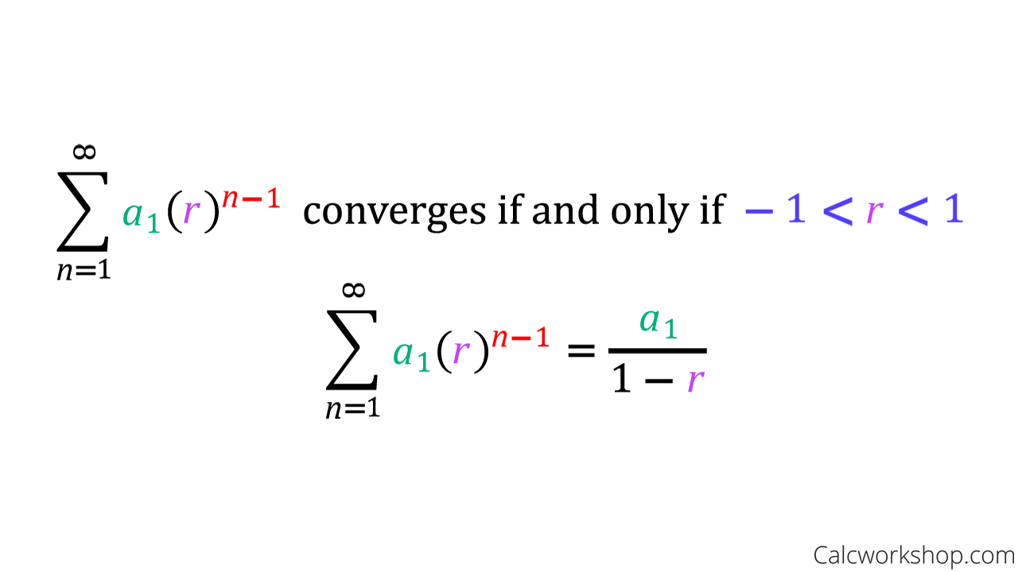
A Geometric Series

Slide 4
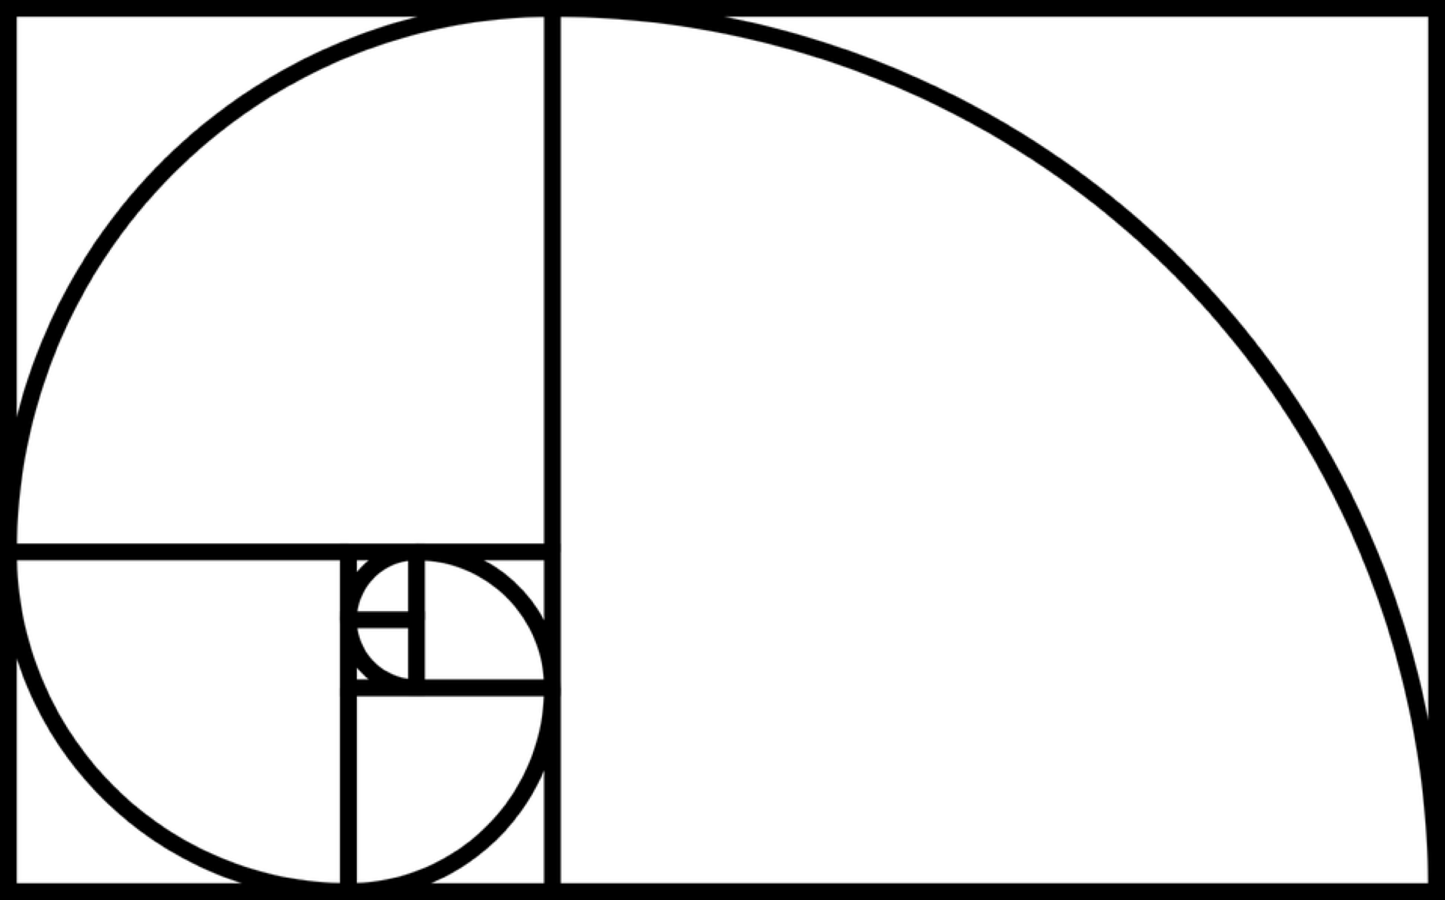
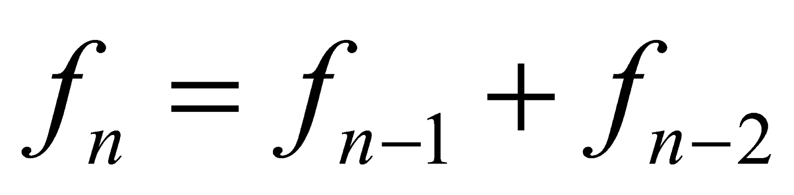
A Fibonacci Series

Slide 5
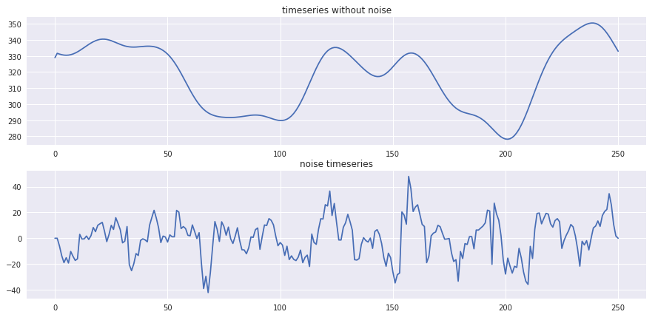
A Time Series

Slide 6
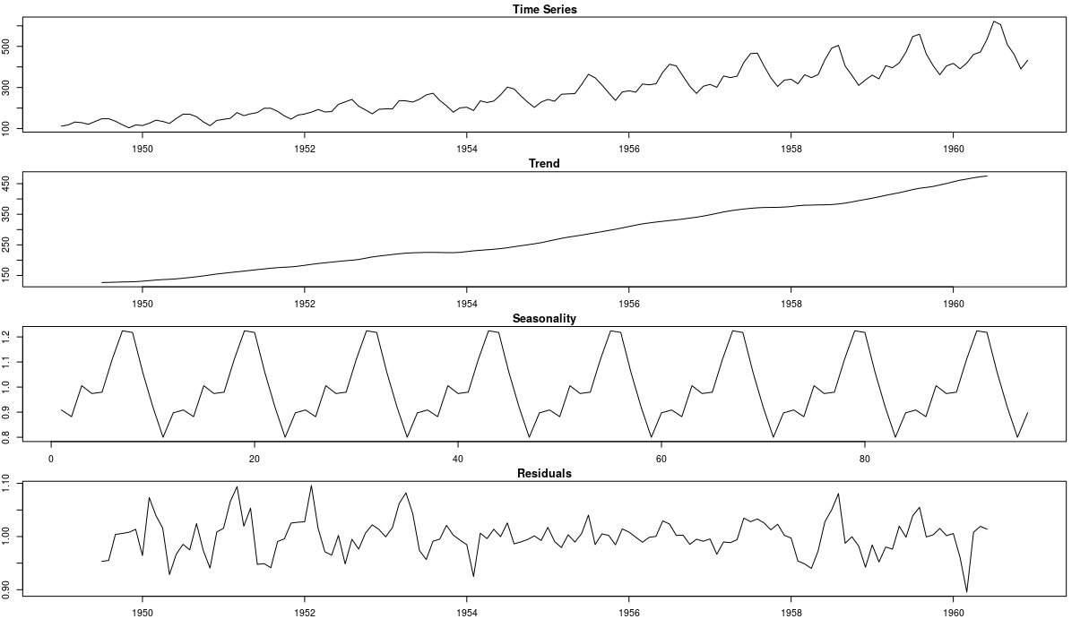
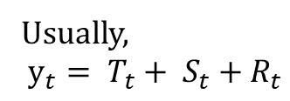
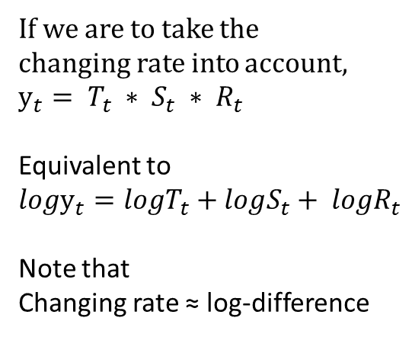
Decomposition of Time
Usually,
$$y_{t}= T_{t}+ S_{t}+R_{t}$$
If we are to take the
changing rate into account,
$$y_{t}= T_{t} ∗ S_{t} ∗ R_{t}$$
Equivalent to
$$logy_{t}=logT_{t}+logS_{t}+ {logR}_{t}$$
Note that
Changing rate ≈ log-difference

Slide 7
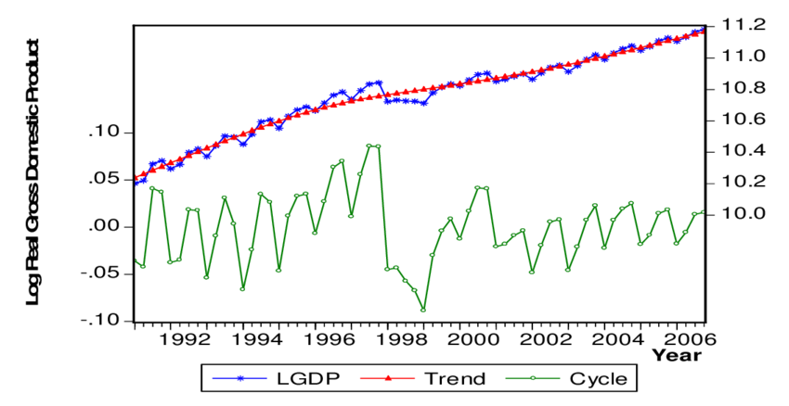
Trend & Hodric-Proscott Decomposition

Slide 8
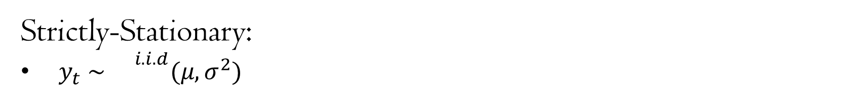
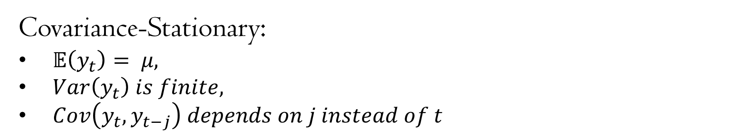
Stationarity Check
Covariance-Stationary:
$𝔼\left(y_{t}\right)= μ,$
$Var\left(y_{t}\right) is finite,$
$Cov\left(y_{t},y_{t−j}\right) depends on j instead of t$
Strictly-Stationary:
$y_{t} \sim {}^{i.i.d}(μ, σ^{2})$

Slide 9
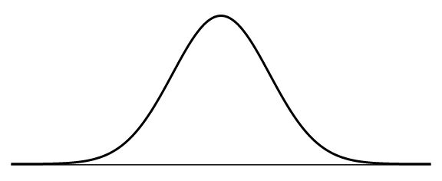
Strictly-Stationary:
$y_{t} \sim {}^{i.i.d}(μ, σ^{2})$
t
Every observed point is assumed as an independent trial from a fixed distribution (Practically infeasible).

Slide 10
Why is Stationarity matters?
As we are unable to estimate the parameter of a time series simply based on a mere sample at each moment once the premise of stationarity is not fulfilled.

Slide 11
Explosive Series
A diverging series is regarded as explosive and is never stationary.

Slide 12

Ordinary Differential Equation (常微分方程式)
&
Growth Factor Modelling
There are a series methods of modelling this way gaining its feasibility in Public Health sector.

Slide 13
Conventionally, we would go the other way by stationalize the time series with different methods.

Slide 14
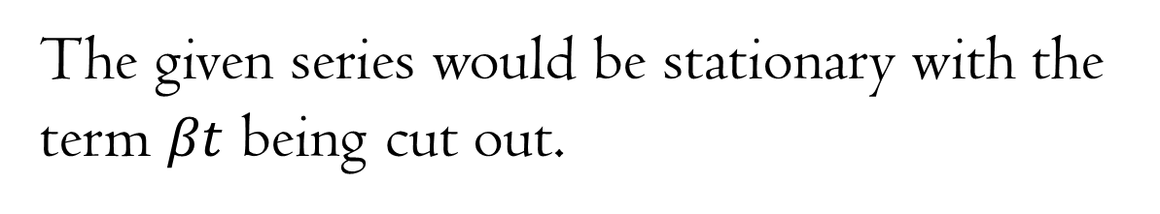

Trend-Stationary Series (去除趨勢后定態)
$$y_{t}= βt+ ε_{t}$$
The given series would be stationary with the term $βt$ being cut out.

Slide 15


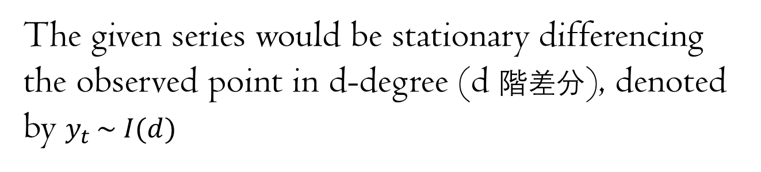

Difference-Stationary Series (差分后定態)
$$y_{t}= y_{t−1}+ ε_{t}$$
$$y_{t−1}= y_{t−2}+ ε_{t−1}$$
$$Δy= ε$$
The given series would be stationary differencing the observed point in d-degree (d 階差分), denoted by $y_{t }\sim I(d)$

Slide 16
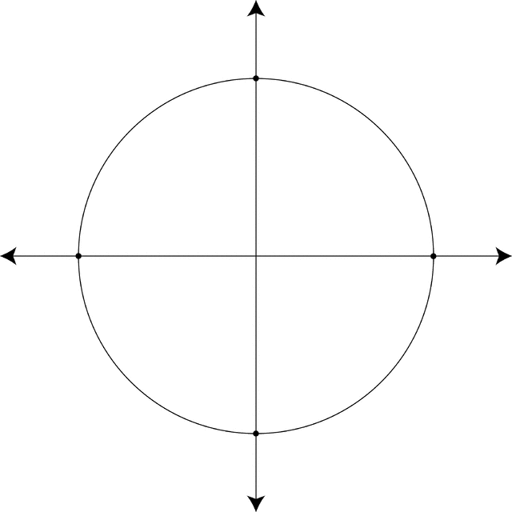

Unit Root Test & Stochastic Trend
$$y_{t}= {βy}_{t−1}+ ε_{t}$$
The test itself has something to do with lag-polynomial, linear algebra, modulus and complex unit circle (ignore this part if you wish).
The test itself implies that the absolute value of β has to be smaller than 1 for it to be predictable.

Slide 17
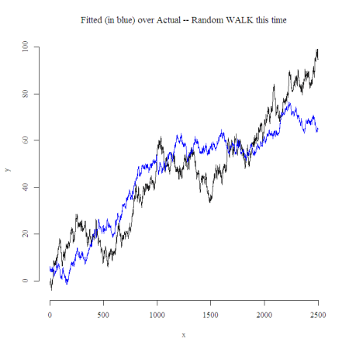
Stochastic Trend & Spurious Regression (虛假回歸)
As a kind of noise fitting.

Slide 18




Slide 19
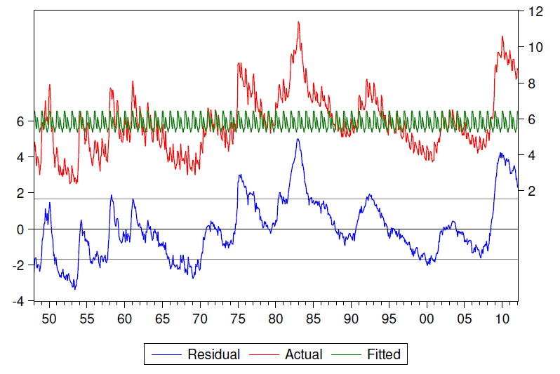
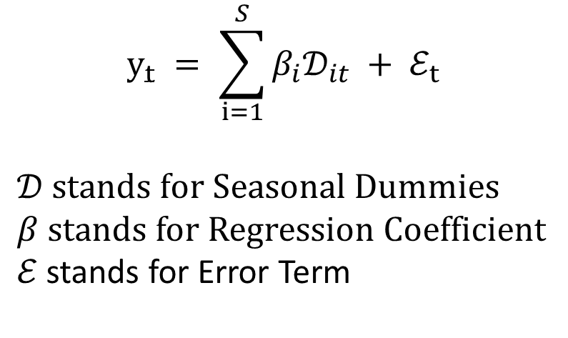
Seasonality & Linear Regression
$$y_{t} = \sum_{i=1}^{S}{β_{i}𝒟_{it}} + ℰ_{t}$$
$𝒟 stands for Seasonal Dummies$
$β$ stands for Regression Coefficient
$ℰ$ stands for Error Term

Slide 20
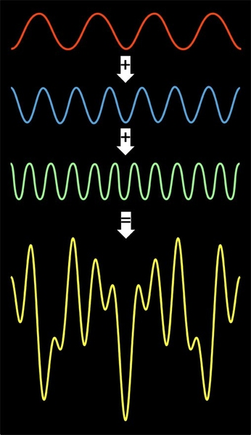
Seasonality
& Discrete Fourier Transformation

Slide 21
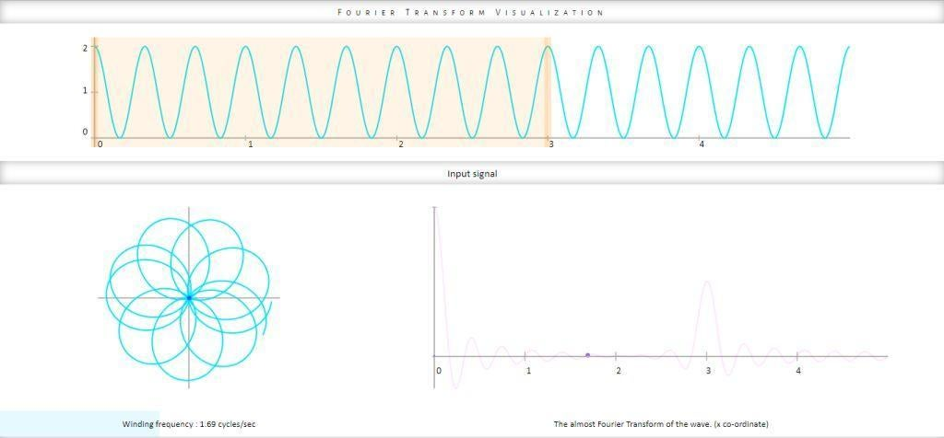
Fourier Transformation

Slide 22
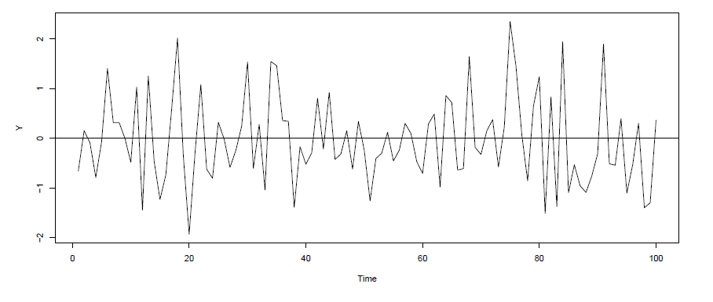


The Error Term
$$ε_{t} \sim {}^{i.i.d}(μ, σ^{2})$$
often regard as
White Noise

Slide 23
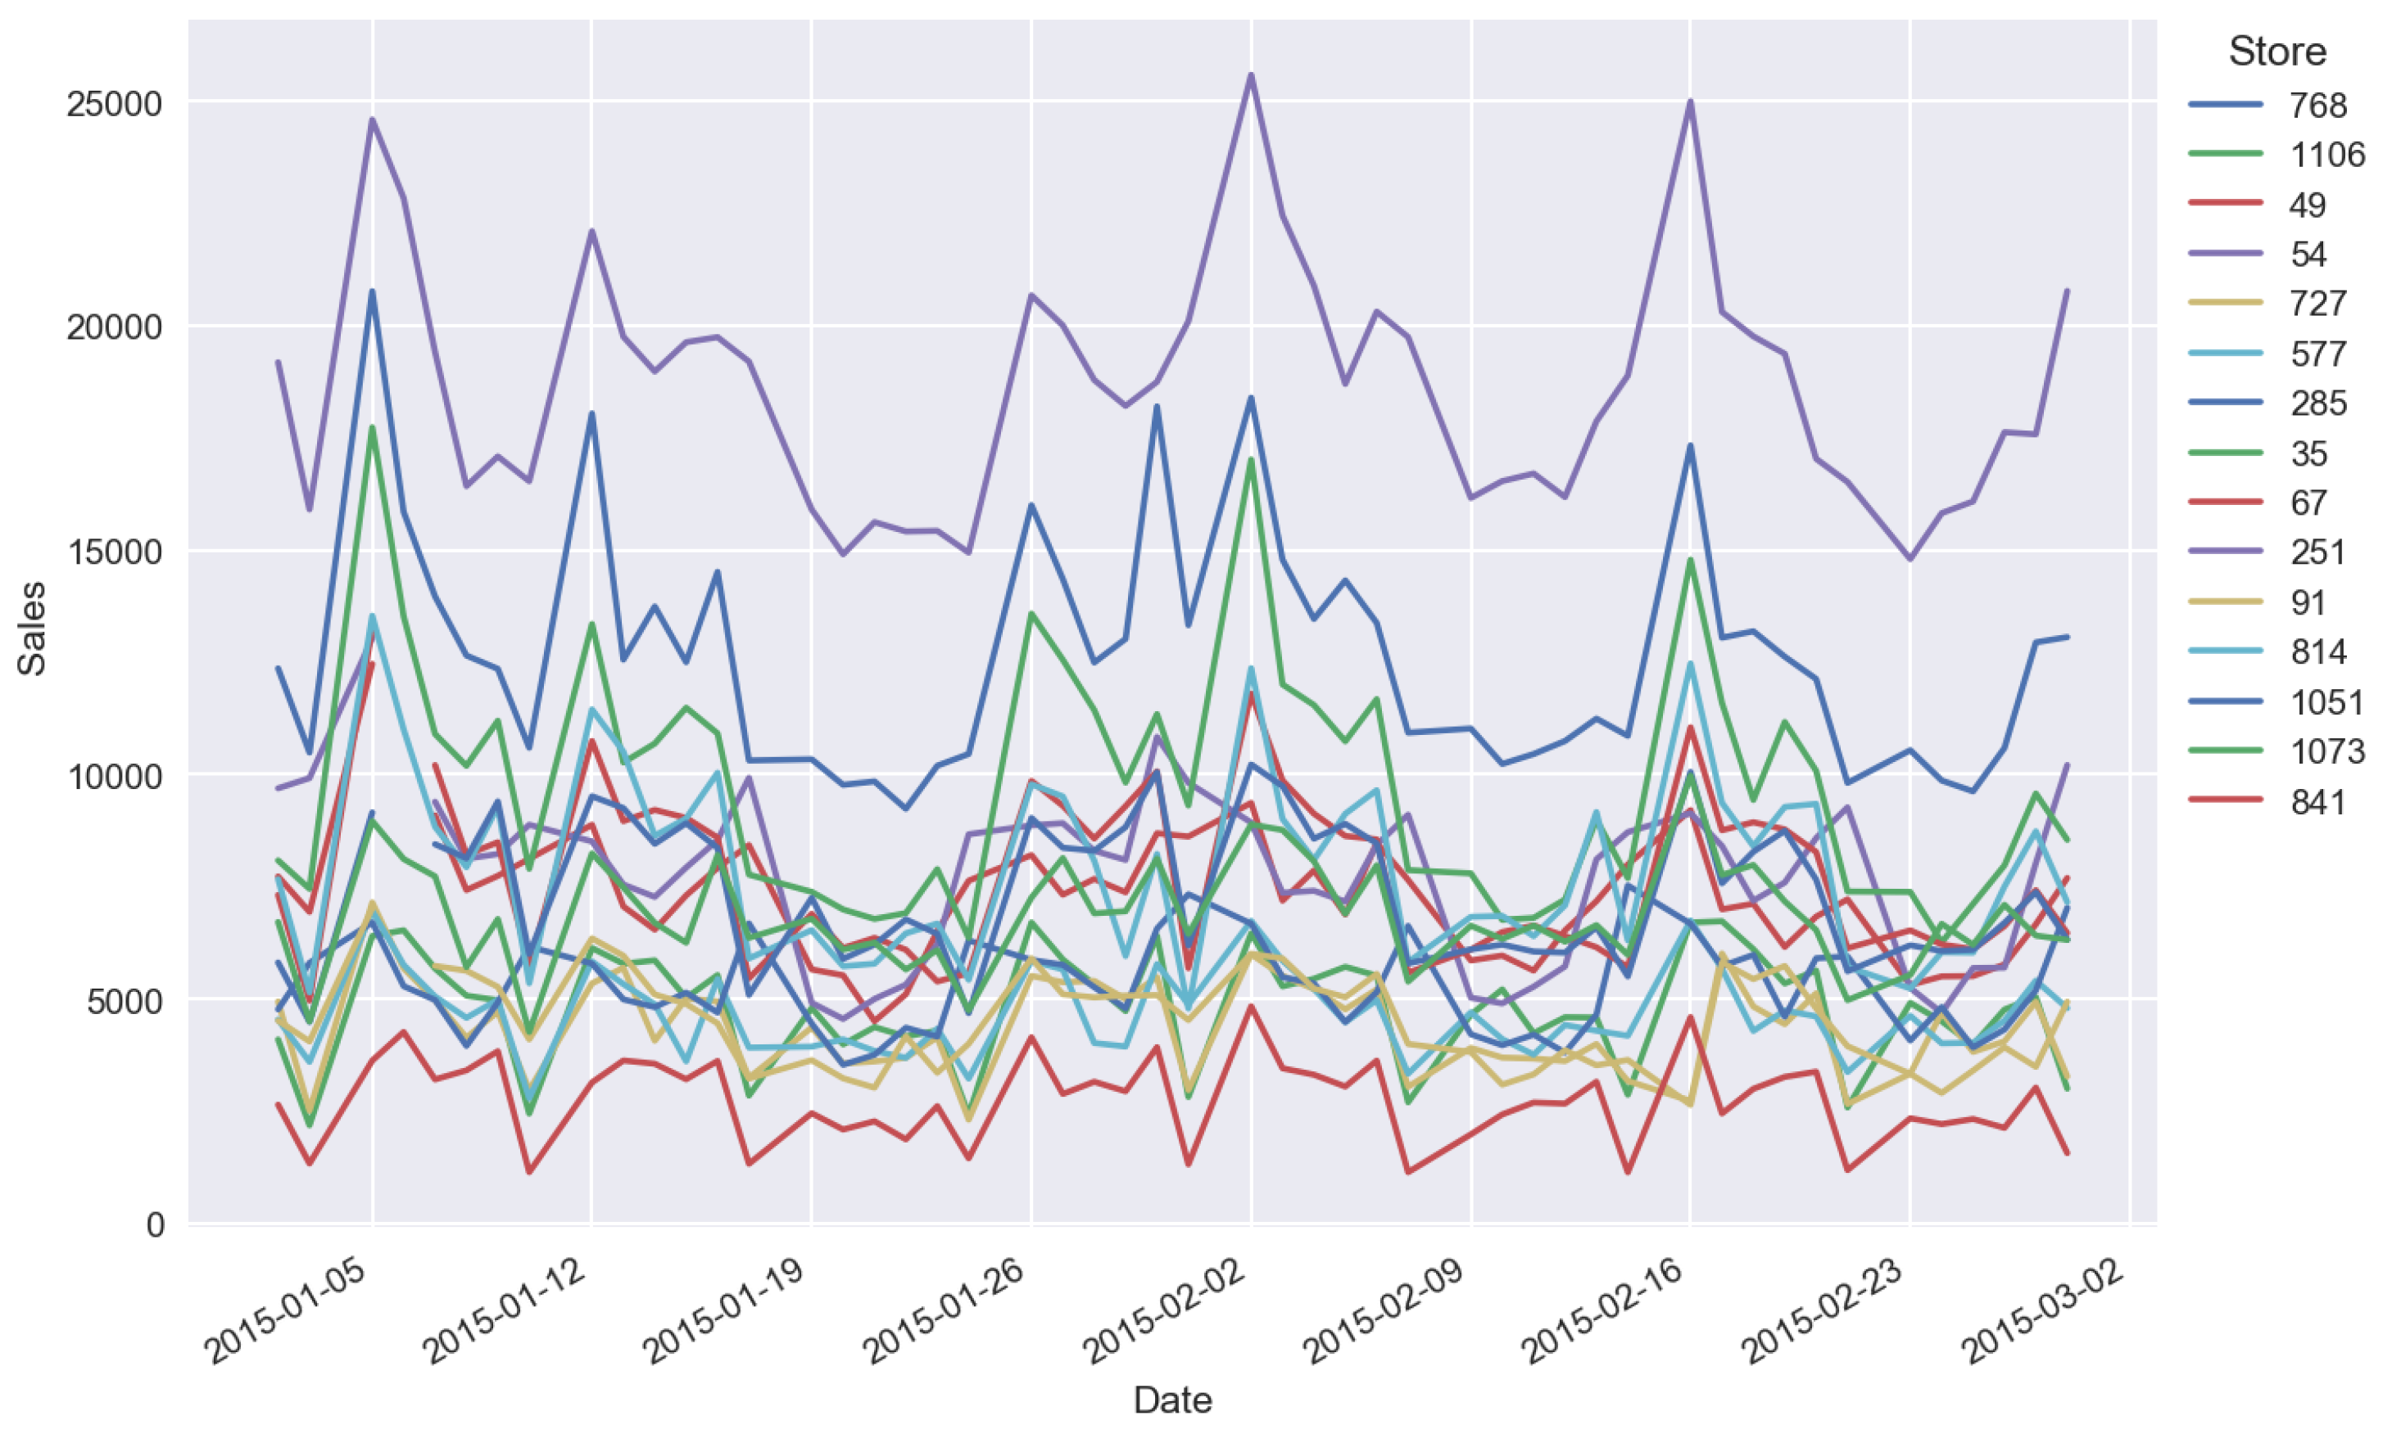
Panel Data Analysis
Multidimensional
Time Series Analysis
*** It has something to do with LLC & IPS Test.

Slide 24
Term-by-Term Deconstruction of
ARIMA

Slide 25
Term-by-Term Deconstruction of
ARIMA
Moving Average Process

Slide 26

A MA(q) Process
$$y_{t}= ε_{t}+ θ_{t−1}ε_{t−1}+ θ_{t−2}ε_{t−2}+ …+ θ_{t−q}ε_{t−q}$$
$$ε_{t} \sim {}^{i.i.d}(μ, σ^{2})$$

Slide 27
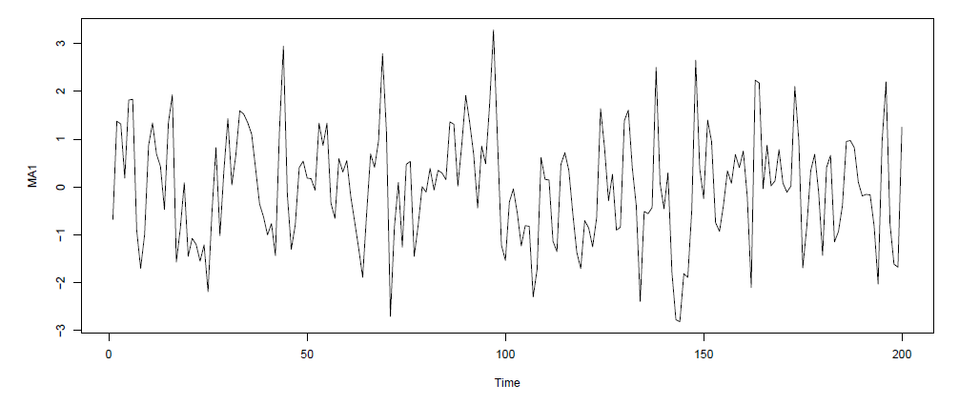
A MA(1) Process
*** with θ = 0.8

Slide 28
Term-by-Term Deconstruction of
ARIMA
Autoregressive Model

Slide 29
An AR(p) Process
$$y_{t}= β_{1}y_{t−1}+ β_{2}y_{t−2}+ …+ β_{p}y_{t−p}+ ε_{t}$$
$$ε_{t} \sim {}^{i.i.d}(μ, σ^{2})$$
Autoregressive as regress on itself.

Slide 30
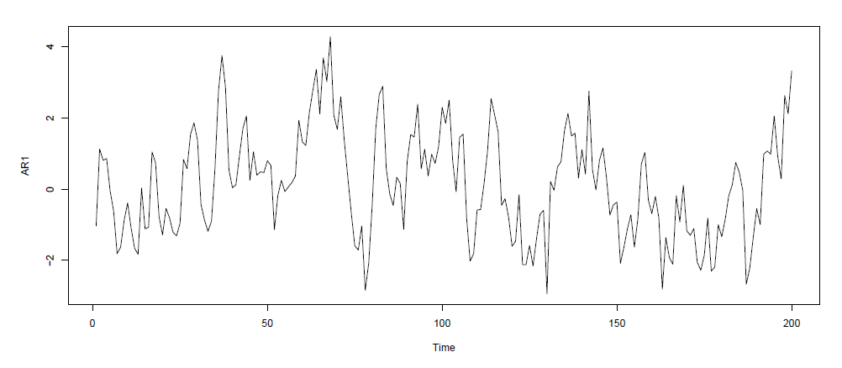
An AR(1) Process
*** with θ = 0.8

Slide 31
Term-by-Term Deconstruction of
ARIMA
Autoregressive Moving Average Model

Slide 32

An ARMA(p, q) Process
$$y_{t}= β_{1}y_{t−1} + …+ β_{p}y_{t−p}+ ε_{t} + θ_{t−1}ε_{t−1}+…+ θ_{t−q}ε_{t−q}$$
$$ε_{t} \sim {}^{i.i.d}(μ, σ^{2})$$

Slide 33
Term-by-Term Deconstruction of
ARIMA
Autoregressive Integrated Moving Average Model

Slide 34


An ARIMA(p, d, q) Process
$$y_{t}= β_{1}y_{t−1} + …+ β_{p}y_{t−p}+ ε_{t} + θ_{t−1}ε_{t−1}+…+ θ_{t−q}ε_{t−q}$$
$$y_{t }\sim I(d)$$
$$ε_{t} \sim {}^{i.i.d}(μ, σ^{2})$$

Slide 35
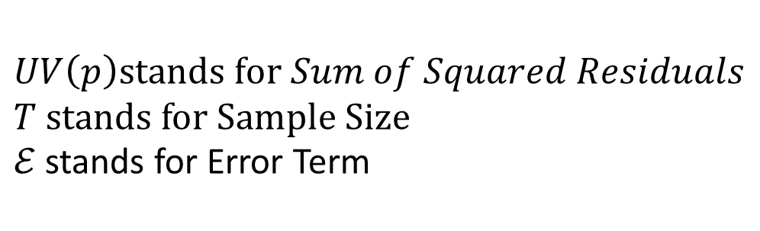
Degree of Lag Selection with Information Criterion
$$Akaike Information Criterion, AIC=log\left(\frac{UV(p)}{T}\right)+(p+1)\frac{2}{T}$$
$$Bayesian Information Criterion, BIC=log\left(\frac{UV(p)}{T}\right)+(p+1)\frac{log T}{T}$$
$$UV\left(p\right)stands for Sum of Squared Residuals$$
$T$ stands for Sample Size
$ℰ$ stands for Error Term
Penalty
The lower the Information Criterion the better.

Slide 36

Thank You
FOR WATCHING AND LISTENING

